Slide 1
Final Project PowerPoint Presentations
Spring 2017
Todd S. Gross

Slide 2
Goal of this presentation
Give an overview of the structure of a good presentation
Offer some opinions (that’s all they are) about visual organization.
Provide constraints and requirements for your presentations so that they are more professional and more informative.
Provide some examples of how you can go wrong
Provide some good examples
Provide some examples of my own presentations that you can pick apart.

Slide 3
The title slide requirements
Members of the group
Group advisor
Date of presentation

Slide 4
Presentation Structure
Statement of purpose – tell the audience why you are presenting this information and what they will learn from the presentation.
Requires you to tune your message to your audience.
Brevity (or lack thereof) depends on the available time
Summary of what will be presented - Outline
Some people think this is important and will refer back to the outline to let the audience know where they are in the presentation.
My opinion is that this wastes time for short presentations. That does not mean you shouldn’t have one, it is just my opinion.
Background information
Present key information/data that puts your presentation in perspective.
The next four slides give a rough example of the title slide and the three bullets above.

Slide 5
Measurement and control of void-nucleating triaxial tensile stresses in resin matrix composites
Todd S. Gross, Hesam Jafari, Jordan Kusch, and Igor Tsukrov University of New Hampshire Department of Mechanical Engineering and
Harun Bayraktar and Jon Goering, Albany Engineered Composites, Inc.
This work was supported by:
NSF grant CMMI-1100409
New Hampshire Innovation Research Center

Slide 6
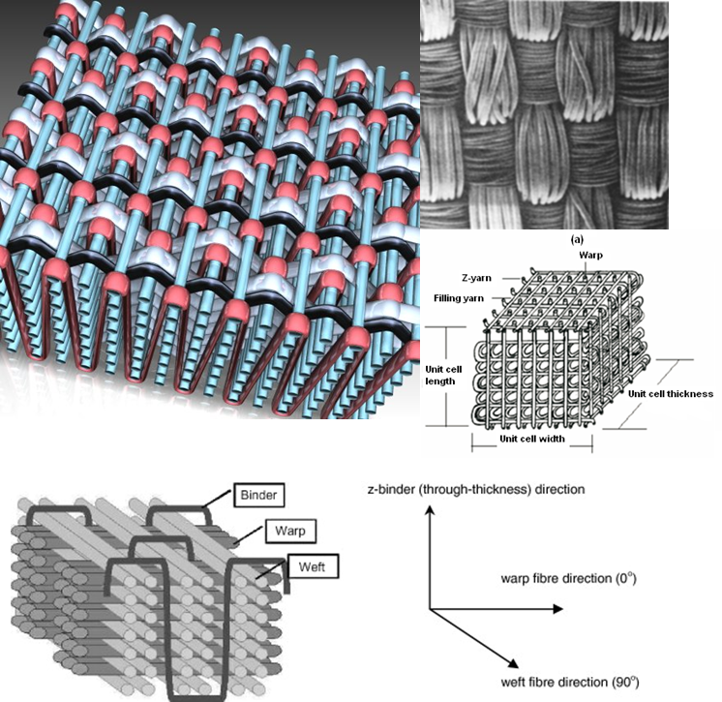
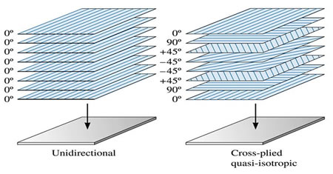
3D woven composite architecture vs. laminated composites: Through the thickness constraint yields improved fatigue performance and resistance to interlaminar shear failure
The font in the diagram is too small
Can anyone read the text in the figure on the lower left? Make sure your fonts are large enough.

Slide 7
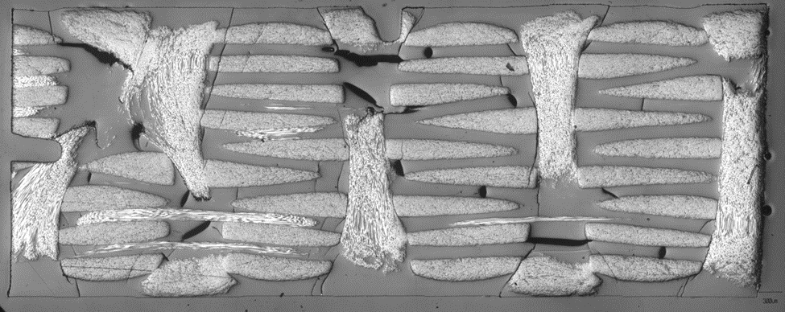
The problem: Through-the-thickness constraint causes resin pocket micro-cracking during curing of 3D woven composites
1 mm

Slide 8
Approach toward understanding effect of process variables on tendency toward resin pocket micro-cracking
Develop finite element model for various 3D architectures to estimate stresses during curing.
Evaluate the effect of different architectures on resin pocket stresses
Challenges include accurately modeling the as-formed architecture and accurately modeling the deformation and failure behavior of the resin matrix especially under equi-triaxial tensile stress.
Determining the failure stress under hydrostatic tensile stress as a function of temperature.

Slide 9
Presentation structure - continued
Experimental methods
How does your experiment fulfill the goal of your project?
What precisely did you measure?
What methods did you use?
Equipment
Preparation
How do you transform your measurements to a result?
Give a sample raw measurement and show how that data becomes a reported quantity.
The next four slides give some good and some bad examples. The font size on plots is almost always to small unless you are careful to make it large enough.

Slide 10
Trixaxial tensile stress is produced by confining epoxy in a low CTE tube during curing Stress is inferred from the distortion of the tube.
Initial
Heat
Cure/Cool
Cool
25 °C
160-180 °C
180-25 °C
25 °C

Slide 11
Precise measurement of tube diameter as a function of temperature
Ambient Temp
Furnace Temp
22 °C
~160 °C
Reference Rods
LVDT
Sample
Sample Rod

Slide 12

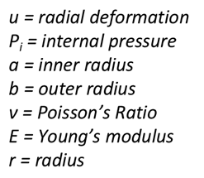





Pressure vessel formula to convert radial displacement to stress
Equations have different fonts which does not look good.
Plane Stress Pressure Vessel Equation
Reduced Pressure Vessel Equation
Plane Strain Pressure Vessel Equation
College of Engineering and Physical Sciences

Slide 13
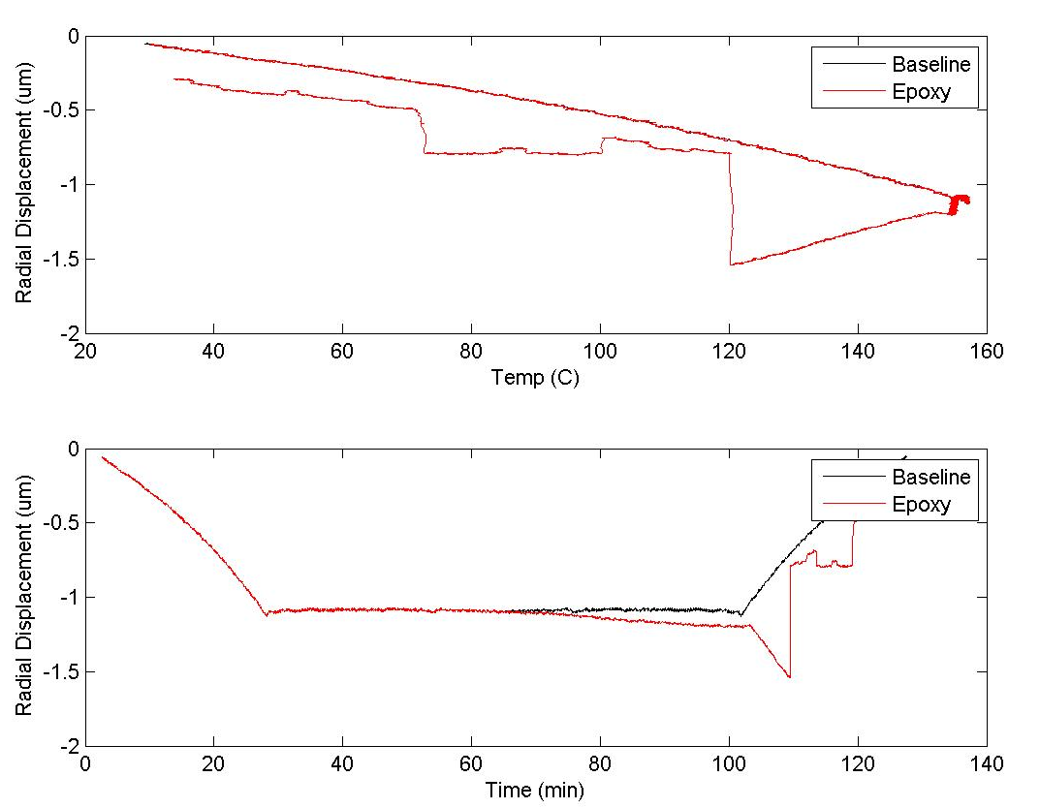
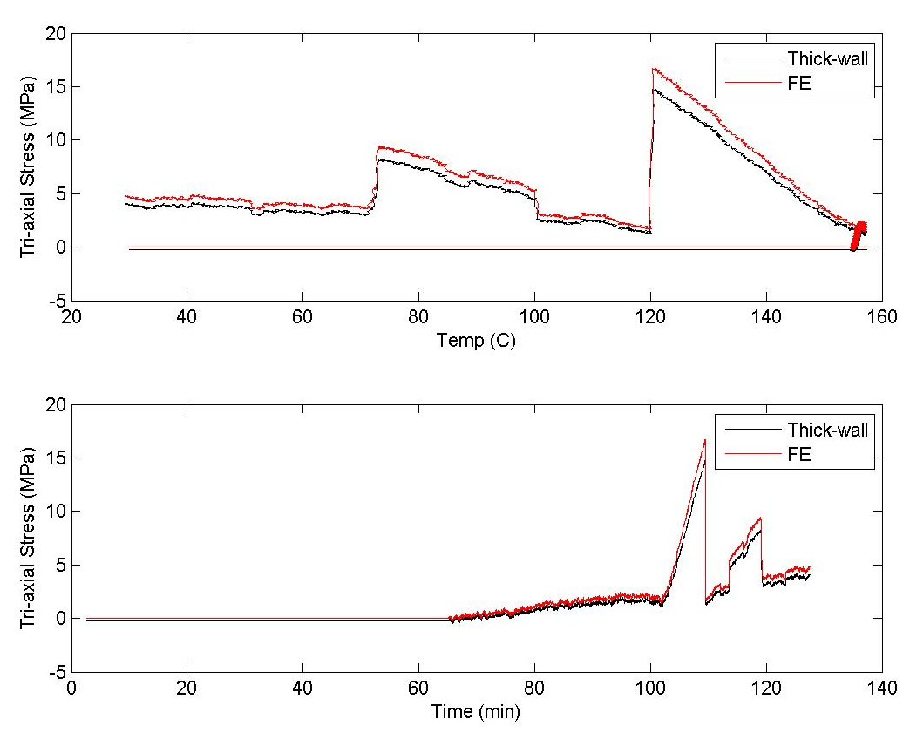
Converting deflection to stress
None of the tick labels or axes labels are large enough. Neither is the font in the bullet list.
Using MATLAB deflections are easily converted to stress by using two methods discussed previously
Difference between epoxy filled tube and an empty tube indicates built up stress from cure shrinkage/CTE mismatch
Fracture happens when stress reaches a specific point
After facture point rest of the data is useless
College of Engineering and Physical Sciences

Slide 14
Presentation Structure - continued
Results and Discussion
Orderly presentation – think about how your audience will absorb the information. If they don’t understand what you are presenting, then they will either tune out, get frustrated, or stop listening and try to read your slides.
Give key results but not all of them.
Make sure your results are visible (font size, axis labels, etc) and clearly labeled.
Concisely state the main point the audience is supposed to appreciate either in the title or in bullets next to or below the result.
Again, some good and bad examples

Slide 15
Elastic property measurements Observation of tension compression asymmetry
 | Tension | Compression | Ultrasonic [1]
E₁ (GPa) | - | 5.2 ± 0.3 | 12.8
E₂ = E₃ (GPa) | 30.2 ± 1.1 | 18.8 ± 0.7 | 27.1
 | - | 0.35 ± 0.007 | 0.22
 | 0.16 ± 0.03 | 0.22 ± 0.01 | 0.35
 | 0.97 ± .04 | - | 0.47
1. Gebert J –M, Reznik B, Piat R., Viering B, Weidenmann K, Wanner A, Deutschmann O, Elastic constants of high-texture pyrolytic carbon measured by ultrasound phase spectroscopy, Carbon 2010; 48:3647-3650

Slide 16
Comments on elastic properties
Modulus normal to growth plane is ~5 GPa and is 18-30 GPa transverse to the growth direction. This is similar to an oriented polymer film but slightly higher magnitude.
Tension-compression anisotropy suggests a puckering mode of elastic deformation in which the graphene-like sheets begin to fold out of plane.
Large Poisson’s ratio (ν =0.97) means that in-plane deformation leads to out-of-plane strains on the same order.

Slide 17
Presentation structure - continued
Summary should list the main conclusions of your presentation
Can be fairly detailed but concise
Can also list questions that arose as a result of your work
Could be followed by Future Work slide/Recommendations slide

Slide 18
Summary of observations
Estimates of elastic modulus by elasto-plastic nanoindentation, microindentation, and ultrasonic measurements normal to growth plane are all ~12 GPa which is a factor of ~2 higher than the macroscopic tests.
Both cube corner and spherical indenters yield a lower in-plane modulus but the macroscopic and ultrasonic tests indicate that the modulus is a factor of 2-6 higher than the out-of-plane modulus (depending on reference value).
Delafargue and Ulm estimates of indentation modulus agree with experimental measurements normal to the growth plane but are much higher that observed for in-plane indentation modulus.
Why does indentation modulus depend on indenter type?

Slide 19
Suggestions for successful presentation
Make sure title and all participants are listed on title page. REQUIRED
Make sure your fonts are legible. Text font should never be less than 16 point if you expect the audience to read it. (Exceptions are for presentations that are also reports.)
Every slide should have an informative title.
Have supporting text to explain figures.
Use schematics instead of photographs because they focus on the important features.
Avoid certain color combinations. White background with black text is boring but effective.

Slide 20
Suggestions for successful presentation - continued
Be familiar with the flow of your presentation before you get up there.
If you are comfortable speaking without notes, practice at least once
If you feel more comfortable having notes, only use them when you cannot remember what comes next. Don’t read your notes.
Don’t look at your slides while you are talking. It distracts you and the audience disconnects.
Control your pace by gauging audience reaction.
Be interested in your presentation.

